Slide 1
Updates to 2014NEIv2 Onroad Mobile Emissions
December 20, 2017
Alison Eyth, Laurel Driver, and Jeff Vukovich
EPA Office of Air Quality Planning and Standards

Slide 2
Purpose
To convey the changes in input data for the 2014 NEI v2 onroad mobile sources
Summarize the changes in the 2014NEIv2 onroad emissions compared to 2014v1
Provide pointers for additional information
Discuss next steps after 2014

Slide 3
Onroad Emission Processes and Inputs
On-roadway emissions
  Exhaust, evaporative, evaporative permeation, refueling, brake and tire wear
  Primary inputs: vehicle miles traveled (VMT), average speeds, speed profiles, and temperature (gridded, hourly)
Off-network emissions (i.e. parked vehicles)
  Exhaust, evaporative, evaporative permeation, refueling
  Evaporative fuel vapor venting: hot soak (immediately after a trip) and diurnal (vehicle parked for a long period)
  Primary inputs: vehicle population (VPOP) and Temperature (gridded, hourly, daily min/max)
Hoteling:
  Extended idle and auxiliary power units (APU) for combination long-haul trucks
  Primary inputs: Hoteling hours and T (gridded, hourly)
Notes:
VMT and HOTELLING are temporalized, others aren’t

Slide 4
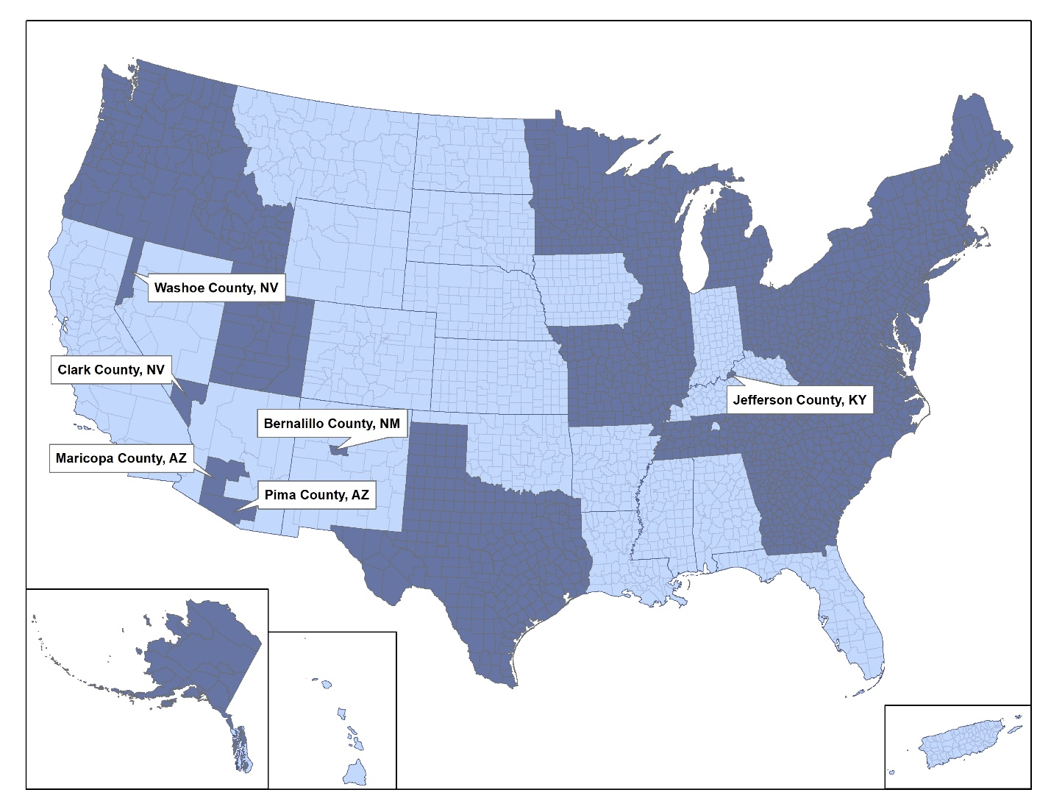
Submitting Agencies
MOVES CDBs provided for over 1,800 counties in 33 states (dark blue areas)
Note:
California
submitted
emissions,
not CDBs
since they
use EMFAC

Slide 5
EPA Default Input Data Preparation
To ensure MOVES inputs are available everywhere,
EPA develops county-specific default data
Activity data
  Vehicle Miles Traveled (VMT)
  Hoteling hours for long-haul combination trucks
  Vehicle Population (VPOP)
  Average Speed distribution and SMOKE speed inputs
Other MOVES input parameters
  Vehicle age distribution
  Fuel type mix
  Fuel properties / market shares
  Temperature and relative humidity
  Road type distribution
  VMT temporal fractions
  I/M compliance / waiver rates

Slide 6
Onroad Emissions Preparation
Hourly Met. Data
from WRF*
Meteorological
Preprocessor
(Met4Moves)
MOVES
Temperature ranges;
rel. humidity by county,
season, temperature
Run MOVES to get emission factors (EFs) for representative counties for each temperature and speed needed
Gridded met
EF tables
Use representative EFs with county/ grid-specific activity data and hourly meteorology to create emissions for all counties
Activity Data
SMOKE
* WRF = Weather
Research and
Forecasting model
AQ model-ready files

Slide 7
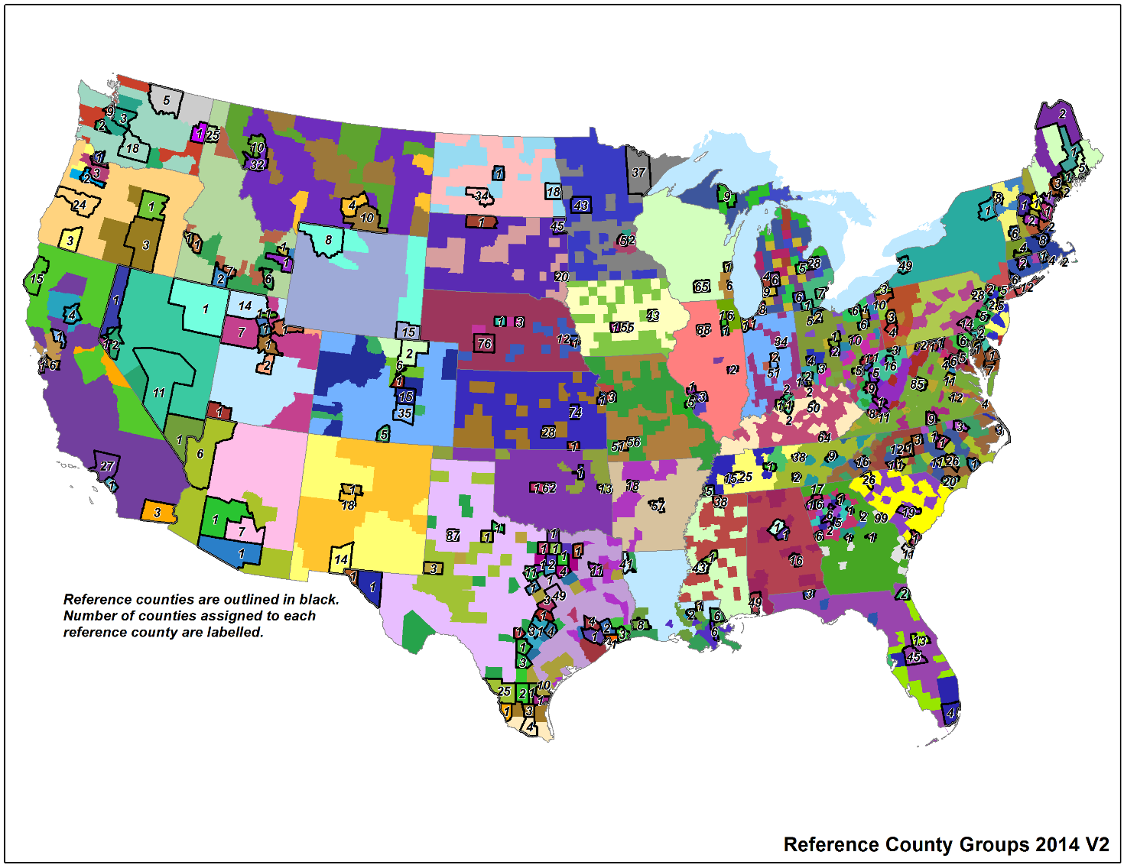
Representative Counties
3000+ US counties are mapped to 303 representative counties according to: state, fuels, age distribution, ramp fraction, inspection & maintenance (I/M) programs, and emissions standards
The criteria for
selecting rep.
counties was
discussed on
MJO in June, 2017
The selection
spreadsheet
will be available
with the v2
documentation
Notes:
Emphasize the county specific activity and the grid specific meteorology is used even if using rep counties.

Slide 8
Updates in 2014NEIv2 Onroad
9 agencies provided 526 newly submitted county databases (CDBs)
  Chattanooga, GA, ME, Memphis/Shelby, TN, VT, WA, WI
  EPA took several steps to quality assure CDBs for v1 and v2
  EPA reached out to submitters for clarification, as needed
Calendar year 2014 VIN-decoding for U.S. counties for both light and heavy duty vehicles
  Model years 1961-2015
  268 million light duty vehicles, 8.6M heavy duty vehicles
  Vehicle population (VPOP) classified into MOVES source types
  Age distributions
  Proportions of alternative fuel vehicles
  Light-duty VMT vehicle splits refined based on new VPOP

Slide 9
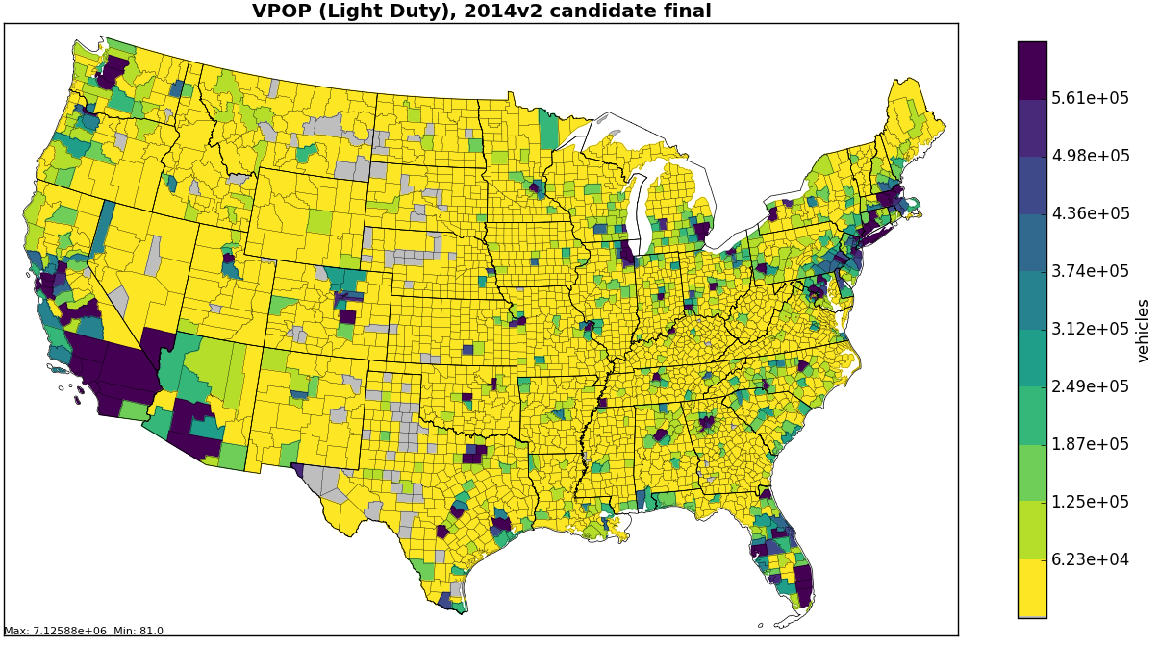
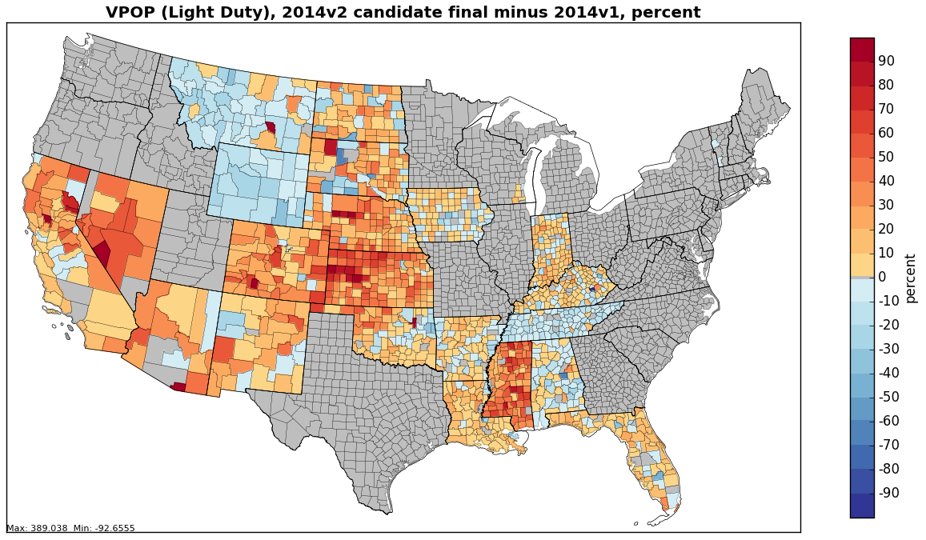
Changes in Light-duty VPOP
Changes to total LD VPOP
are due to state
submissions and EPA
default data updates

Slide 10
Refinement of Representative Counties
Starting with the 2011NEI, representative counties that would have similar emission factors were selected on the basis of similar:
  State, LD fleet age, I/M programs, fuel controls (e.g., low RVP gas in summer), % of ramps, and altitude
For 2014NEIv2, the factors of LD fleet age,
I/M programs, % ramps were reevaluated
  The reason for the most changes was the new fleet ages
12 new representative counties were added in 2014NEIv2 for a total of 303 rep. counties
Note: MOVES is run in inventory mode for all counties in AK, HI, PR, and VI

Slide 11
Overview of VMT Development
Data used:
2014 NEI VMT
County-level VMT (VM2) from FHWA by road type
Use county population data to fill gaps in FHWA data
VMT by county and road type
County population data from U.S. Census
VMT by county, road type, and HPMS vehicle type
Allocate VMT by road type to HPMS vehicle types
FHWA fractions (VM4) vehicle type by road type
VMT by county, road type, and MOVES vehicle type
Distribute VMT to MOVES vehicle types
IHS 2014 vehicle pop data
Distribute VMT to MOVES fuel types and road types
VMT by county, MOVES road type, vehicle type, and fuel type
IHS 2014 fuel splits by source type

Slide 12
Overall changes in VMT/Hoteling
Total LD and total HD VMT did not change much in v2
  Newly submitted data (or acceptance of EPA data)
  Bus VMT dropped about 5% as a result of QA
The allocation of the county-level FHWA VMT to the MOVES source types was updated according to the source type populations in the IHS data
  For medium to heavy duty vehicles, the representativeness of the IHS distributions for each source type were taken into account in this process
  Long-haul combination truck VMT was not changed from v1

Slide 13
Light-Duty Source Type VPOP/
VMT Allocation
  2014 IHS VPOP data was used to allocate VMT from HPMS vehicle types MOVES source types
  For Light-Duty cars and trucks
    County-level fractions were developed for each MOVES source type within each HPMS vehicle category
      County level fraction (21) = POP₂₁/(POP₂₁ + POP₃₁ + POP₃₂)
      where 21=passenger car, 31=passenger truck, 32=light commercial truck
    County-level VMT by HPMS vehicle type was also multiplied by the MOVES source type fraction
    States with higher than average passenger car fractions in v1 tend to have higher passenger truck fractions in v2

Slide 14
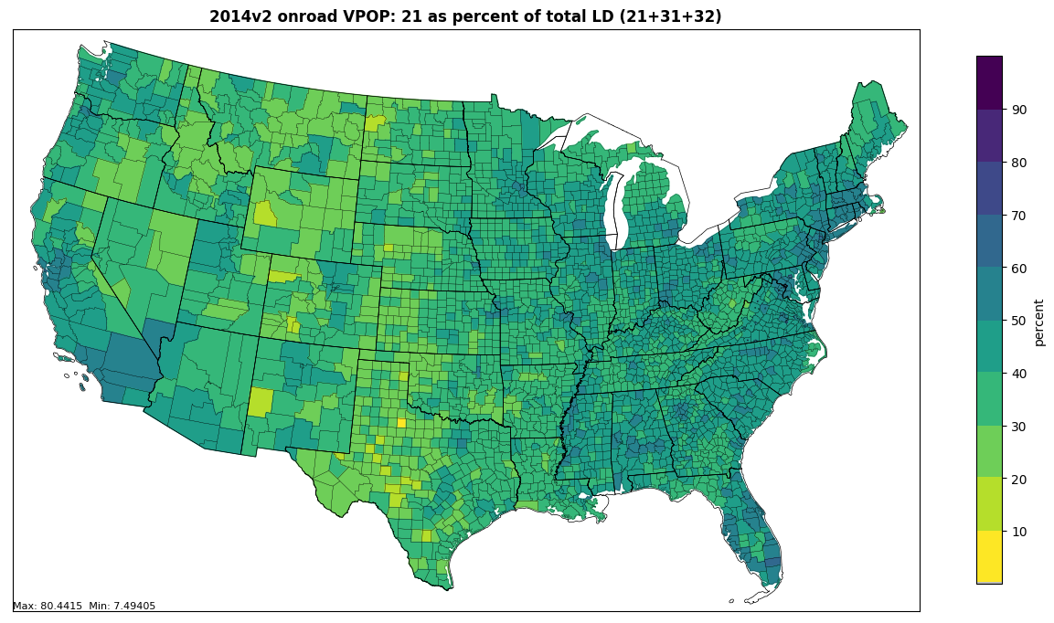
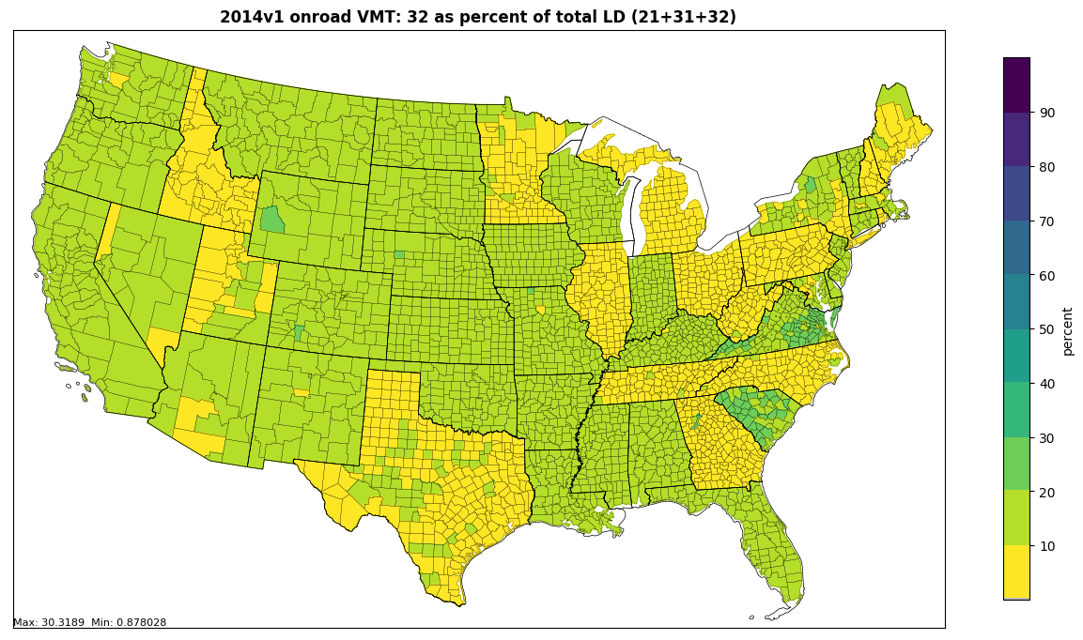
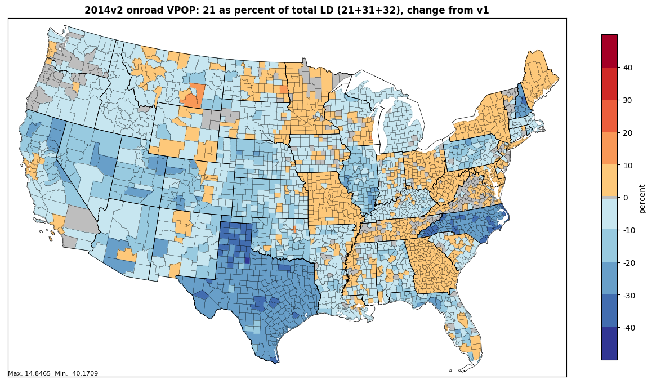
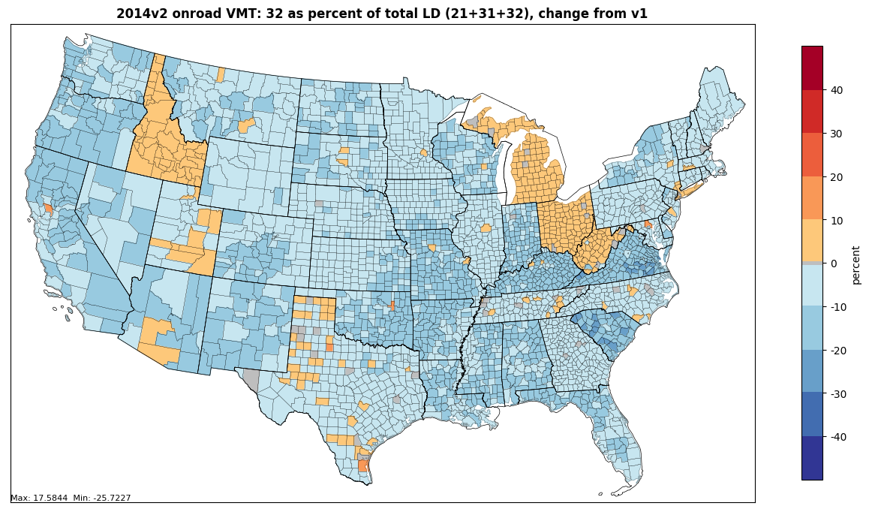
Impact of Light-duty reallocation
Passenger cars as % of light-duty in v2
Light commercial trucks as % of light-duty in v2
Percent change in passenger cars
as % of light-duty (v2-v1)
Percent change in light commercial trucks as % of light-duty (v2-v1)

Slide 15
Heavy-duty VMT/VPOP changes
Combo-truck VMT unchanged from 2014 v1 but hoteling hours adjusted down in areas where hoteling hours were much higher than available spaces could support
Heavy-duty VMT/VPOP (miles/vehicle) ratios in submitted data were reviewed and found to be unrealistic in some states for some source types
  VPOP should be reflect of the vehicles in the area, so that off-roadway emissions (parking, etc) can be computed
  Some states approved used of EPA default data for problematic source types

Slide 16
Additional Input Data Updates from the CRC A-100 Study
Sponsored by the Coordinating Research Council (CRC)
Main data source: StreetLight Data, Inc.
  5 Billion observations over continental U.S.
  Passenger cars, commercial truck fleet management systems
  Sub-minute level data for 12 consecutive months
  Grouped by light-duty (LD), medium-duty (MD), and heavy-duty (HD); no car/truck split or age info available for LD vehicles
  5m spatial precision, 16 speed bins
Used data to derive
  VMT temporal distributions for MOVES and SMOKE temporal profiles
  Road type distributions supplemental to those from FHWA
  Speed distributions for MOVES plus speed inputs to SMOKE
    Populating all speed bins by road type, month, day, hour, vehicle type was a challenge outside of urban areas

Slide 17
CRC A-100 Geographic Scale
18,644,352 road segments over
the Continental U.S.
3,601 polygons of urban areas / clusters from the U.S. Census
* CRC A-100 plots courtesy ERG

Slide 18
Spatial Groups
Example of Passenger Vehicles on Urban Unrestricted Roads
Counties for
which MOVES
inputs could be
populated
shown in red;
others are based
on data for
the region and
urban/rural

Slide 19
Speed Results by City
ERG compared Atlanta, Chicago, and Las Vegas
Patterns differed by city and from MOVES defaults
  Weekday patterns for passenger vehicles on urban restricted roads (highways) and unrestricted local roads shown below
  Note scales differ

Slide 20
Speed by Vehicle Type
Found speed differences between LD, MD, and HD
  MD/HD speeds higher than LD in many cases
  Different areas have different patterns esp. on interstates
Chicago examples shown below – note scales differ

Slide 21
Hour VMT Distributions by
Vehicle Type – Chicago example
Note the differences in patterns weekdays vs weekends and LD/MD/HD
Data put into formats to support MOVES (weekday/weekend) and SMOKE (day-specific)

Slide 22
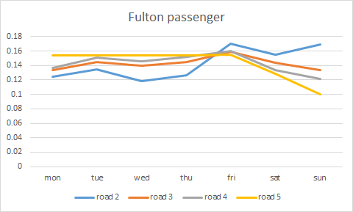
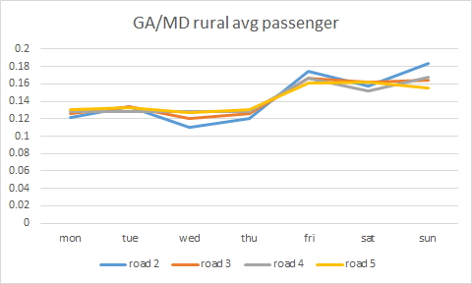
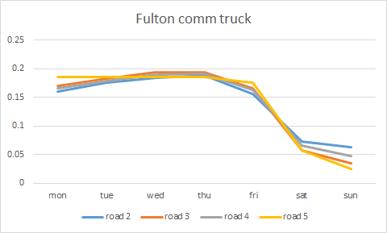
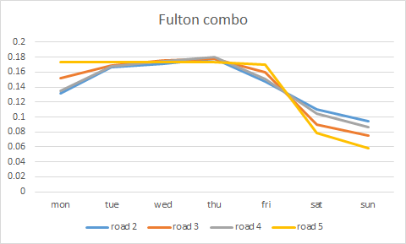
Day of Week Temporal Profiles
A-100 data was prepared into MOVES dayVMTFraction and SMOKE day-of-week temporal profiles (SMOKE shown here)
Urban GA LD vehicles
RURAL GA LD vehicles
Urban GA MD trucks
Urban GA combination trucks

Slide 23
Weekday / Weekend VMT
MOVES, the day type VMT fraction input is allowed to vary not by month, road type and vehicle type (July shown here)
  Note some differences by area

Slide 24
Default Table Contents (1)
Note: Tables not listed on this or next slide are empty by default
CDB Table | Default content for 2014 NEI v2
avft | 2014 IHS data
avgspeeddistribution | CRC A-100 study
dayvmtfraction | CRC A-100 study
fuelformulation | Based on EPA estimates for each county – updated with 2014 refinery data
fuelsupply | Based on EPA estimates for each county – updated with 2014 refinery data
fuelusagefraction | MOVES2014a default E85 usage
hotellingactivitydistribution | MOVES2014a default APU vs. Main Engine fractions
hotellinghours | 2014 EPA estimates of hoteling based on 2014 long-haul combination truck VMT
hourvmtfraction | CRC A-100 study

Slide 25
Default Table Contents (2)
See 2014v2 Plans for CDB input data spreadsheet for state-specific info
CDB Table | Default content for 2014 NEI v2
imcoverage | 2014 NEI v1
monthvmtfraction | 2014 NEI v1
roadtype | 2014 NEI v1 (ramp fraction of 0.08 is default value if table empty)
roadtypedistribution | EPA estimates based on FHWA
sourcetypeagedistribution | 2014 IHS data
sourcetypeyear | 2014 IHS population data, with EPA modification
sourcetypeyearvmt | 2014 EPA estimates of VMT based on FHWA data and 2014 IHS data
zonemonthhour | 2014 meteorology data averaged by county
emissionratebyage | The `emissionratebyage` tables for some counties were populated using appropriate data described in the guidance for states adopting California emission standards

Slide 26
2014 V2 – v1 comparisons
Pollutant | Con. U.S. v1 | Con. U.S. v2 | v2-v1 (tons) | v2-v1 % change
CO | 21,545,725 | 24,141,968 | 2,596,244 | 12%
NH3 | 103,332 | 107,683 | 4,351 | 4%
NOX | 4,622,651 | 4,835,324 | 212,673 | 5%
PM10 | 307,077 | 301,466 | -5,612 | -2%
PM2_5 | 157,965 | 161,731 | 3,766 | 2%
SO2 | 28,324 | 28,093 | -231 | -1%
VOC_INV | 2,173,521 | 2,350,068 | 176,548 | 8%
These numbers do not include AK, HI, PR, VI, or Tribal submissions

Slide 27
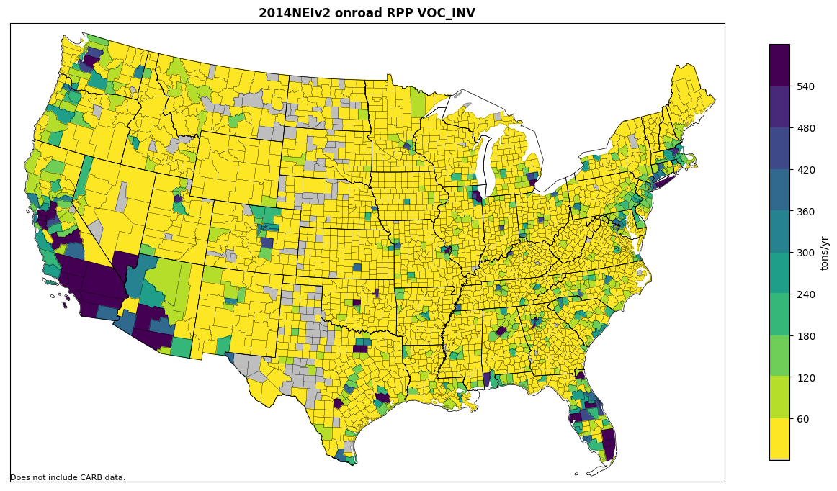
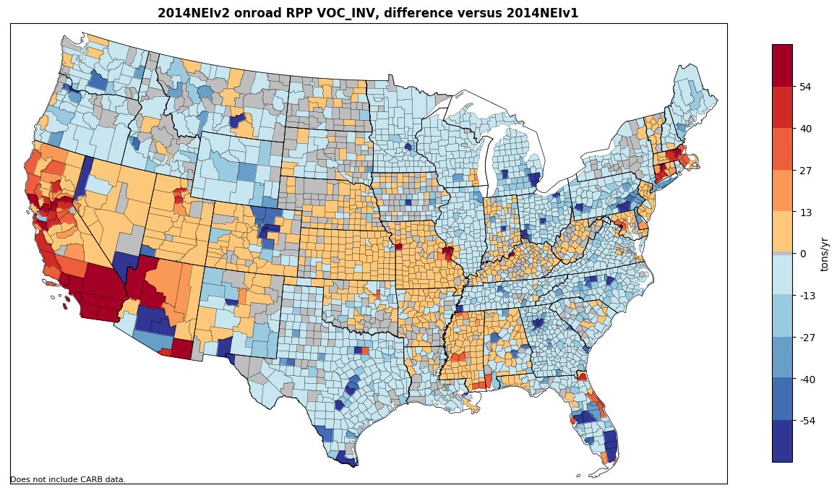
Rate per Profile VOC and changes
This is a small category
focused in population
centers (200K of 2.4M tons VOC)
Emission changes are small

Slide 28
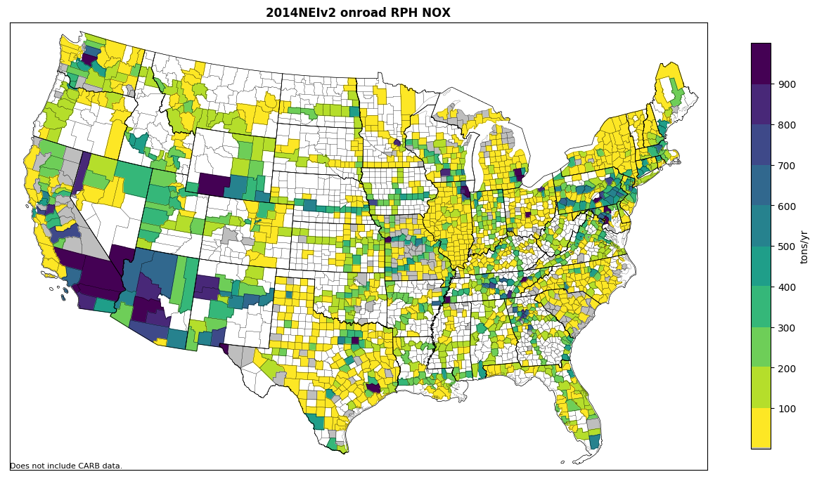
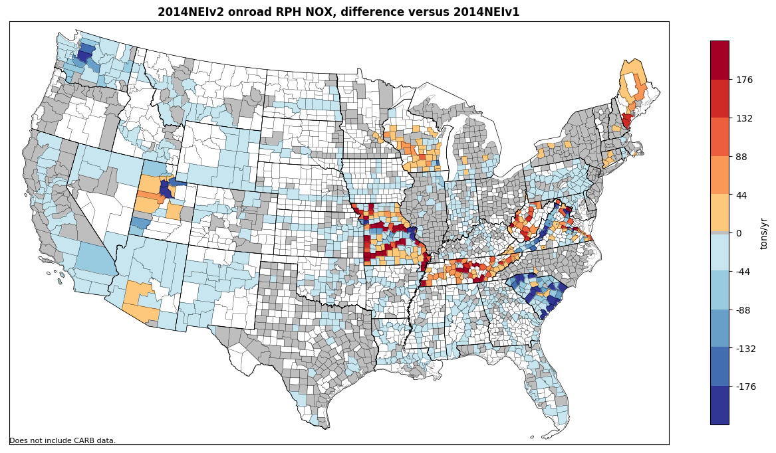
2014v2 Hoteling NOx and changes
Many areas unchanged
Some state-specific
updates where activity
changed
187K tons of 4.8M tons

Slide 29
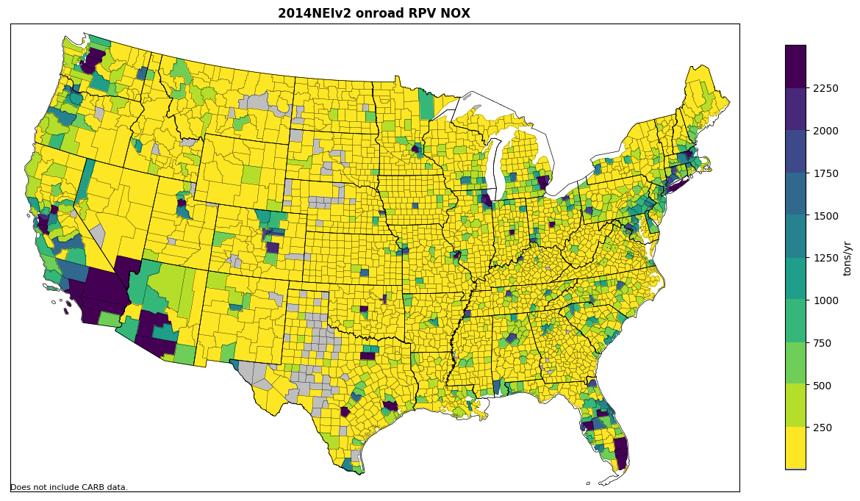
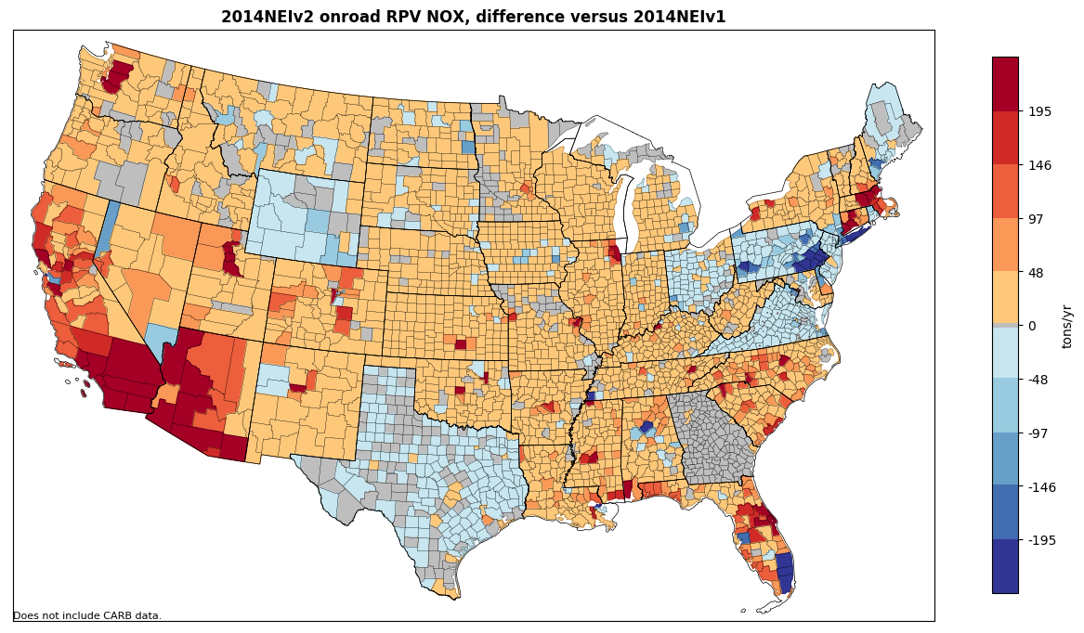
Rate per Vehicle NOx and changes
This category of modest
emissions (746K of 4.8M tons)
is concentrated in higher
vehicle population areas
Changes vary by state based
on level of activity changes

Slide 30
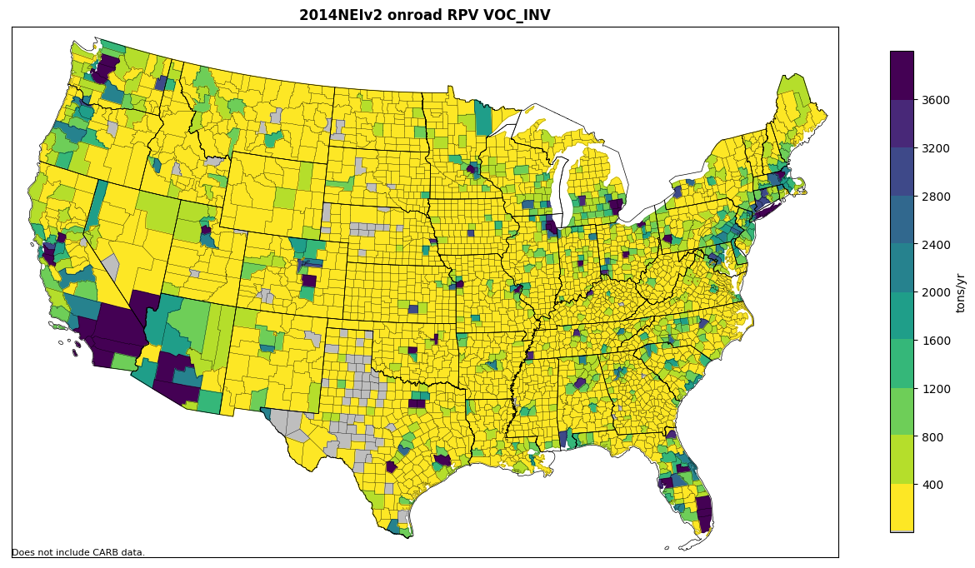
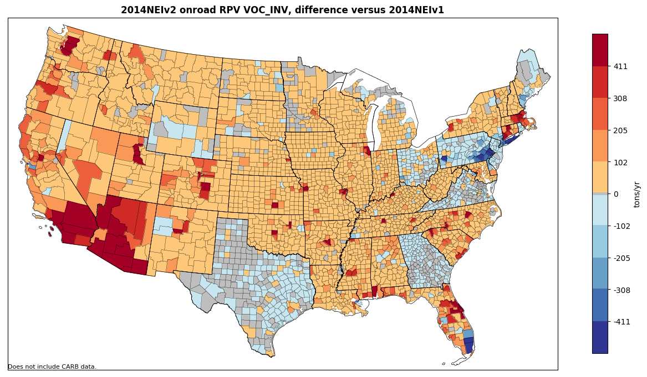
Rate per Vehicle VOC and changes
RPV is an important
contributor for VOCs
1.3M of 2.4M tons
Modest increases in many states

Slide 31
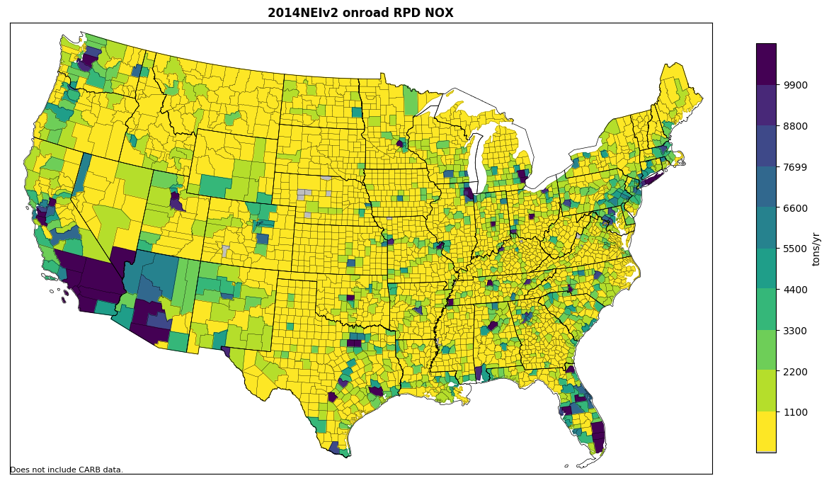
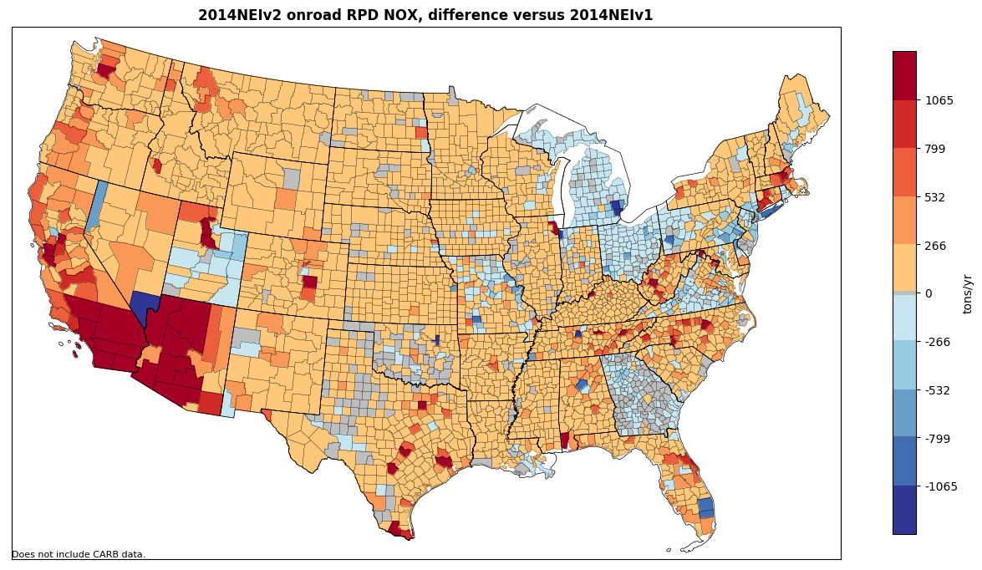
Rate per Distance NOx and changes
RPD is the largest onroad NOx
contributor and is on roadways:
4.1M of 4.8M tons. VOC patterns
look similar (900K of 2.4M tons)
Updates to speeds and VMT splits
caused some increases from v1
Note: California emissions
changes based on MOVES,
not EMFAC; there are no
changes to CA onroad in v2

Slide 32
Data to be Posted for Download
Seeded CDBs for emission factor mode modeling
  For representative counties only
  Includes small numbers in key fields so emission factors are generated for all potential source and road types
  Age distributions averaged across represented counties
Unseeded CDBs for inventory mode modeling
  For all counties
  Includes county-specific activity data (including holes where they exist)
Activity data in SMOKE format (VPOP, VMT, hoteling)
  Scripts to put activity into and get it out of CDBs
Package of scripts and ancillary data to run SMOKE-MOVES (including rep. county and fuel mappings)
Other files updated such as those listed in 2014v1 TSD

Slide 33
References
Improvements to Default Data for the On-road Sector of the 2014 NEI (ERG)
  https://www.epa.gov/sites/production/files/2017-10/documents/denbleyker.pdf
CRC A-100
  https://crcao.org/reports/recentstudies2017/A-100/ERG_FinalReport_CRCA100_28Feb2017.pdf
WA 5-08 Task 1 memo (ERG, July 2017)
2014NEIv2 EPA Default Onroad Activity Data Documentation (January, 2018)

Slide 34
Sources of Additional NEI and Modeling Information
Air Emissions Inventory Website
  https://www.epa.gov/air-emissions-inventories
  2017 NEI Plan
  2014 NEI Documentation and Data
  2011 NEI Documentation and Data
Air Emissions Modeling Website
  https://www.epa.gov/air-emissions-modeling
  2011 Emissions Modeling Platforms
  2014 Emissions Modeling Platform(s)
  Includes Technical Support Documents (TSDs), inventory data, scripts, summary report spreadsheets

Slide 35
What’s Next?
2016 modeling platform
and 2017 NEI

Slide 36
A New Process Unfolds
Regional modeling organizations and states asked to be more involved in the development of the next modeling platform
  States need a new platform to develop State Implementation Plans for the 2015 National Ambient Air Quality Standards for Ozone, and also for Regional Haze
  States often have better access to local information
  States and regions would like to have more input into the methods used, particularly those used to develop “projections” of emissions to future years
For the first time, EPA is supporting a collaborative process to develop a new emissions modeling platform for 2016

Slide 37
Organizational Structure of the 2016 Effort
Overall co-leads: Zac Adelman of the Lake Michigan Air Directors Consortium (LADCO) and Alison Eyth of EPA
  Coordinate communication, develop processes to be followed,
  help resolve issues, specify documentation requirements, facilitate distribution of data to stakeholders
Coordination committee: regional, state, EPA leaders that help define the process, run workgroups, and resolve issues that come up
Sector-specific Workgroups: co-led by one regional/state and one EPA staff (where possible) with participants from states/locals/regions and EPA
  Focus on preparing emissions estimates for 2016 and future years, plus improve modeling of the emissions sectors

Slide 38
2016 Platform Schedule
2014NEIv2 is needed as the starting point
Several versions of 2016 platform will be developed
  Alpha: preliminary version with 2016 emissions for some sectors and 2014 for the rest (February, 2018)
  Beta: improved version of 2016 emissions for most sectors and preliminary projected emissions to 2023 and 2028 (Summer-Fall, 2018)
    Timing of projections is uncertain
  V1.0: fully updated 2016 emissions and complete projected emissions for 2023 and 2028
  (Winter, 2019)

Slide 39
Starting Point Emissions for 2016
The 2014 National Emissions Inventory, version 2 (2014NEIv2) will be the starting point for many sectors (especially nonpoint sectors)
Point source submissions for 2016 are due from states January, 2018 – draft 2016 point inventory will be available in March
Electric generating unit (EGU) emissions will use 2016 Continuous Emissions Monitoring Systems (CEMS) data
Onroad mobile source emissions based on 2014NEIv2 inputs projected to 2016 will be available
Nonroad mobile source emissions based on inputs for 2014NEIv2 will be available
Wild, prescribed, and agricultural fire emissions for 2016
Biogenic emissions for 2016
Other sectors may be adjusted to 2016 (e.g., oil and gas)
Recent emissions modeling improvements to temporal allocation, spatial allocation, and speciation can be incorporated

Slide 40
Plans for Sharing Inventories
Workgroup status available on WIKI:
http://vibe.cira.colostate.edu/wiki/wiki/9169
Google Drive area for sharing data
Planning a coordinated release of 2014, 2015, and 2016 emission inputs in February
  2014 will be NATA but with fewer toxics
  2015 will be ORD/CDC inputs
  2016 will use the alpha inventories
New FTP site for emissions platforms
  ftp://newftp.epa.gov/Air/emismod/

Slide 41
Overlap of 2016 with 2017 NEI Preparation
The NEI schedule has submittals due by the end of December, 2018 (grace period extends into January, 2019)
  This overlaps with the 2016 platform development
Technical issues tackled during 2016 development can also be applied to 2017
  Examples how best to use the VIN-decoded data for VPOP and VMT and how to allocate hoteling hours
Many input data sets can be consistent or similar between the two years
  FHWA data for 2016 is now becoming available
  2017 data should become available by early 2019
  There will likely be some tweaks to 2016 for 2017

